Slide 1
Introduction to Visual Analytics
Mod.100/1

Slide 2
Outline

Visual Analytics
Definition, Motivations, Objectives, Applications.

Data Visualization
Fundamentals, Different kinds of Visualization charts and graphs, Visualization Dashboards, Applications.

Slide 3
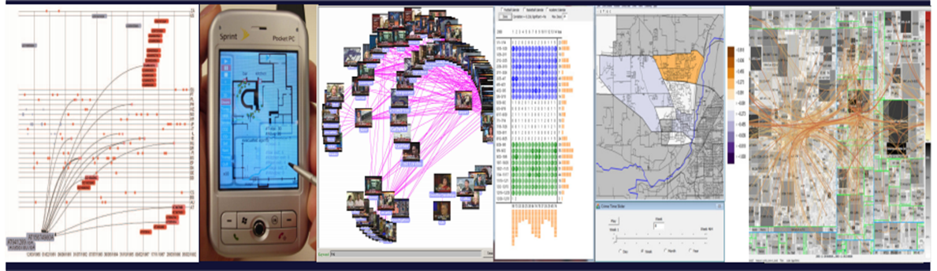
Visual Analytics
Visual Analytics is the science of analyticsl reasoning facilitated by interactive visual interfaces.
Visual analytics combines automated analysis techniques with interactive visualization for effective understanding, reasoning and decision making on the basis of very large and complex datasets.

Slide 4
Visual Analytics
The basic idea is the integration of the capabilities of humans in terms of visual information exploration and the processing power of computers to form a powerful knowledge discovery environment.
It involves the user into the data analysis loop.

Slide 5
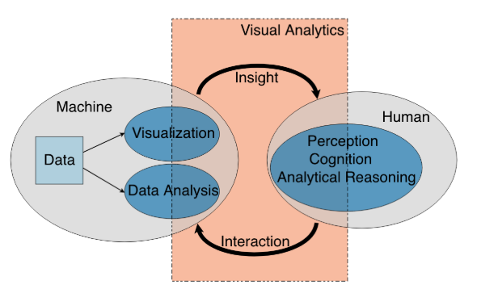
Visual Analytics as the interplay between Visualization, Data Analysis, Interaction, and Human Analytical reasoning.
Visual Analytics
Cui, W. (2019). Visual Analytics: A Comprehensive Overview. IEEE Access, 7(June), 81555–81573. https://doi.org/10.1109/ACCESS.2019.2923736

Slide 6
Data Visualization
Graphical representation of data.

Slide 7
Graphical representation of data and information for:
Data Visualization
Presentation of data, concepts, relationships;
Confirmation of hypotheses;
Exploration to discover patterns, trends, anomalies, structures, associations;

Slide 8

High Bandwidth Connection to the human brain
Data Visualization
Data visualization is a high bandwidth connection between data on a computer system and a human brain, facilitated by visual communication.
Data acquisition
Data processing
Data display
Human perception
Human memory
Human cognition

Slide 9
Advantages:
Data Visualization
Facilitates understanding of both large-scale and small-scale features of the data.
External artifact supporting decision making.
Functions as cognitive tools.
Facilitates hypothesis formation.
Enables problems with the data to become immediately apparent.
Improving cognitive systems often means optimizing the search for data and making it easier to see important patterns.

Slide 10
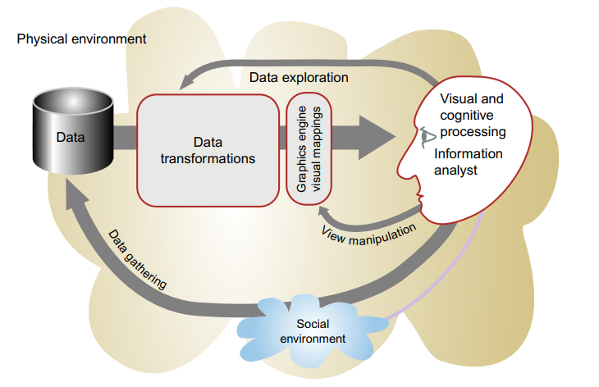
The Visualization process:
Data Visualization
The process of data visualization includes four basic stages.
The collection and storage of data
A pre-processing stage to transform the data
Mapping from the selected data to a visual representation
The human perceptual and cognitive system (the perceiver).

Slide 11
Types:
Data Visualization
Mathematical Visualization
Scientific Visualization
Information Visualization
Domain Specific Visualization

Slide 12
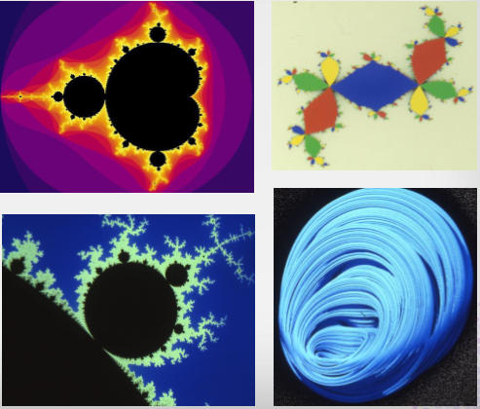
Mathematical Visualization:
Data Visualization
Data results from mathematics
Missing data can be readily generated by the computer

Slide 13
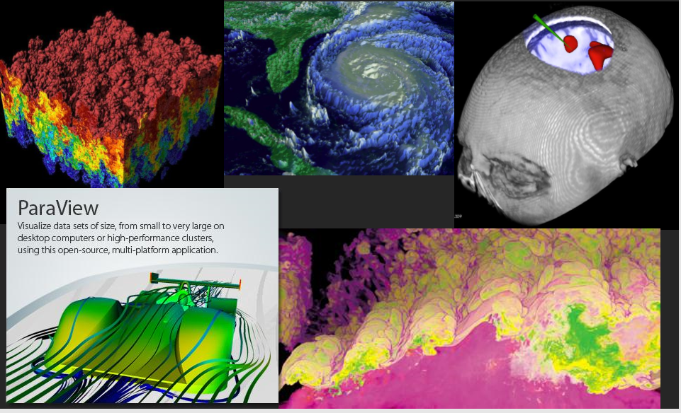
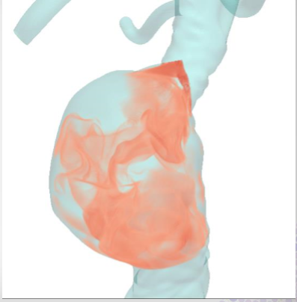
Scientific Visualization:
Data Visualization
Visualization of scientific data
Data measured or via lengthy, expensive simulations
Structural Data
Coordinate data
spatial coordinates
temperature, pressure, etc.
time can be a spatial dimension

Slide 14
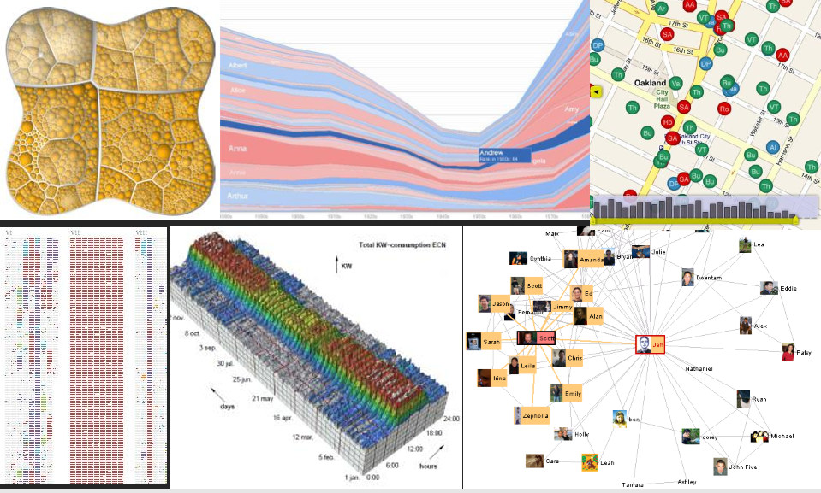
Information Visualization:
Data Visualization
Visualization of more abstract, non-coordinate data
Relies more heavily on processing abstract data into a more concrete form that can be more effectively perceived by an observer.
No inherent structure – News, stock market, top grossing movies, Facebook connections

Slide 15
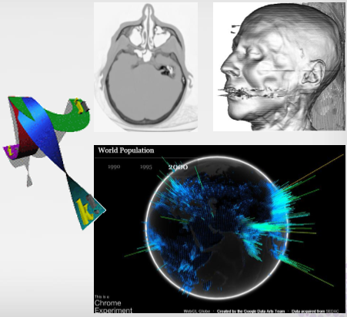
Domain Specific Visualization:
Data Visualization
Medical Imaging
Business Intelligence
Educational Visualization
Geographical Information Systems

Slide 16
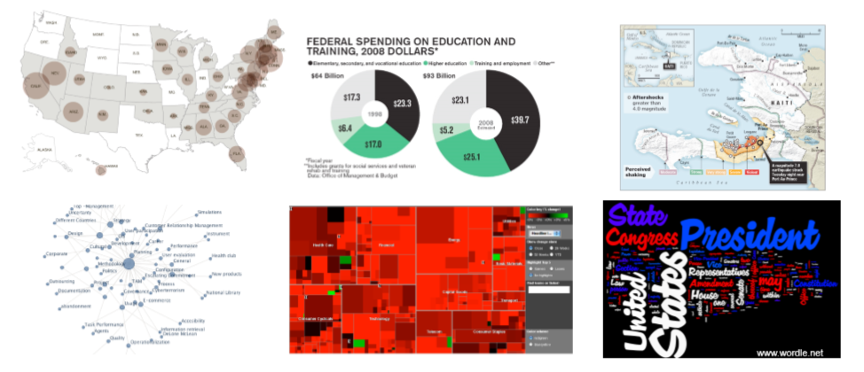
Ultimate Goal:
Data Visualization
To convey information through visual representations to gain insight (hidden truth)

Slide 17
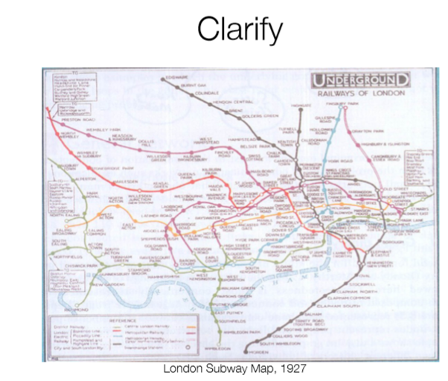
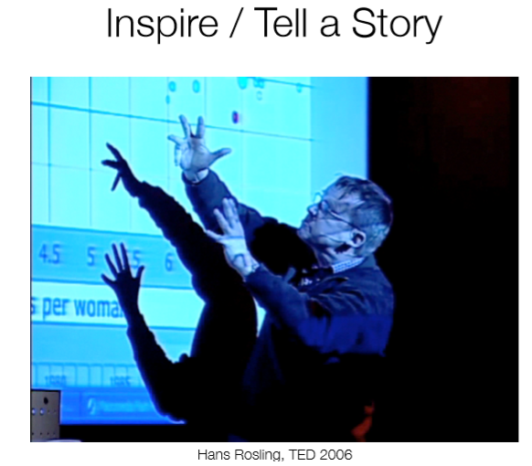
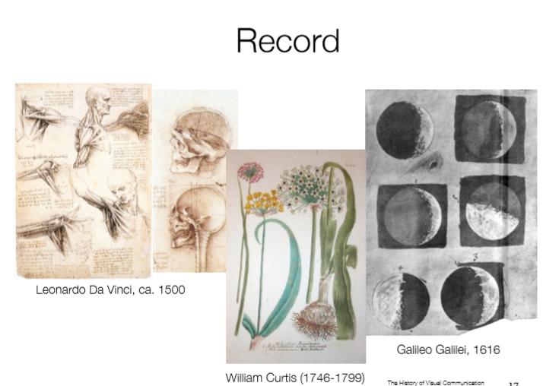
Ultimate Goal:
Data Visualization

Slide 18
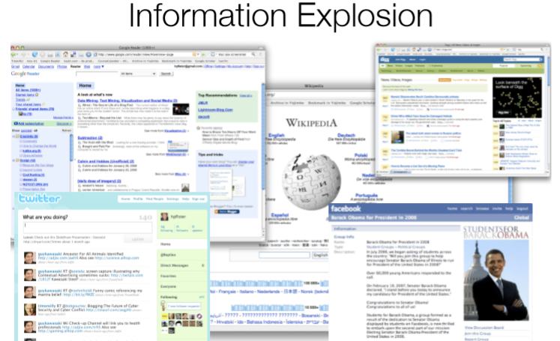
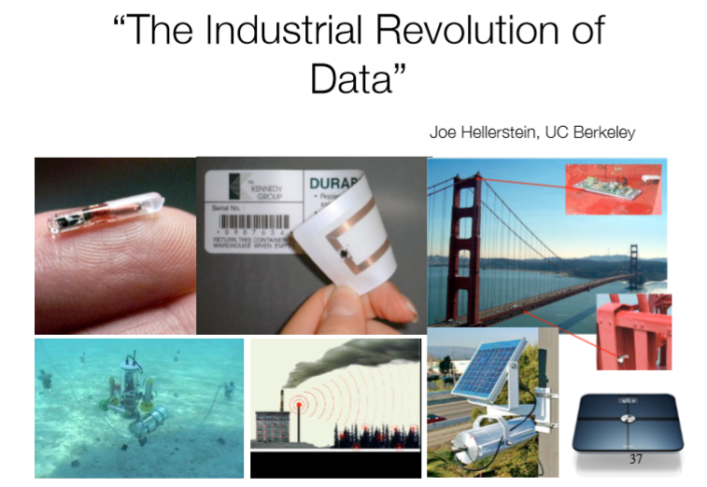
Why Visualization?
Data Visualization
Data-driven era

Slide 19
Models:
Data Visualization
Presentation Visualization
Used for communication
Intended for large group or mass audience
Does not support user input
Highly polished
Interactive Visualization
Used for discovery
Intended for a single investigator or collaborators
Re-renders based on input
Prototype quality

Slide 20
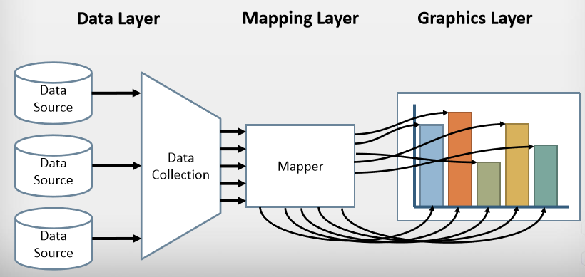
Framework:
Data Visualization
Data Layer
Locating and obtaining data
Importing data in proper format
Relating data for proper correspondence
Data analysis and aggregation
Graphics Layer
Conversion of geometry into displayable image
Decorations
Managing interaction
Mapping Layer
Associating appropriate geometry with corresponding data channels
Data analysis and algorithms (e.g. contouring)

Slide 21
Data:
Data Visualization
Refers to discrete, objective facts in a digital form when organized and arranged leads to information that useful in answering some questions about the business.
A good visualization is not just a static picture that can be looked at, it is something that allows us to drill and find more about the change in data.

Slide 22
Data Types:
Data Visualization
 | Discrete | Continuous
Ordered | Ordinal, e.g. size: S,M,L,XL,… Quantitative, e.g. counts: 1,2,3,… | Fields, e.g. altitude, temperature
Unordered | Nominal, e.g. shape: Rect.., Cir.., Tri.. Categories, e.g. nationality | Cyclic values, e.g. directions, hues

Slide 23
Data as Variables:
Data Visualization
Science | Databases | Data Warehouses
Independent Variable | Key | Dimension
Dependent Variable | Value | Measure

Slide 24
Charts Types:
Data Visualization
Various Plots and charts that are commonly used for Visualization
Comparison and ranking
Correlation
Distribution
Location-specific of geo-data
Part-to-whole relationships
Trends over time

Slide 25
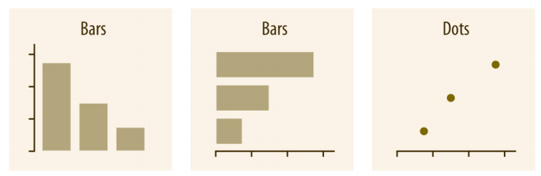
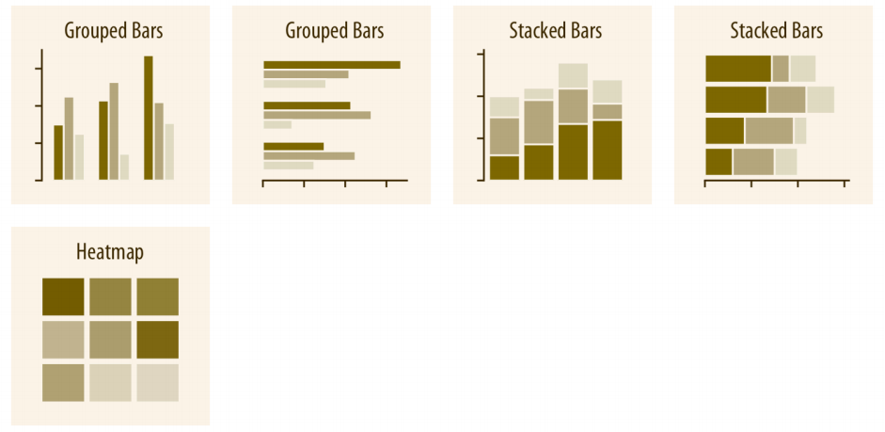
Charts Types: Amount
Data Visualization
Numerical values shown for some set of categories.
Stacked bars: two or more set of categories
Map the categories onto x and y axes and show amount by Color via Heatmaps

Slide 26
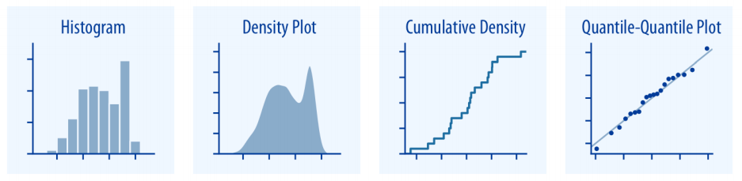
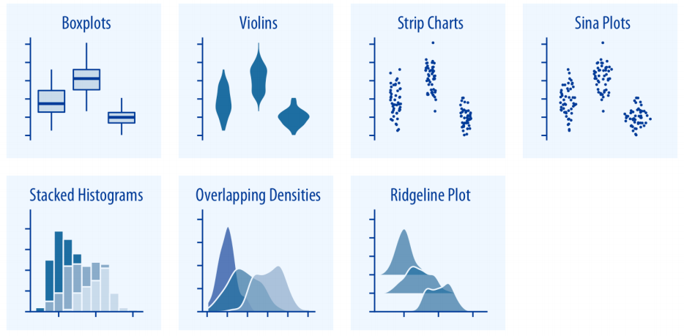
Charts Types: Distributions
Data Visualization
Many distributions at once (Boxplots, Violin Plots, Strip Charts)
Stacked histograms and overlapping densities allow a more in-depth comparison of a smaller numbers of distributions

Slide 27
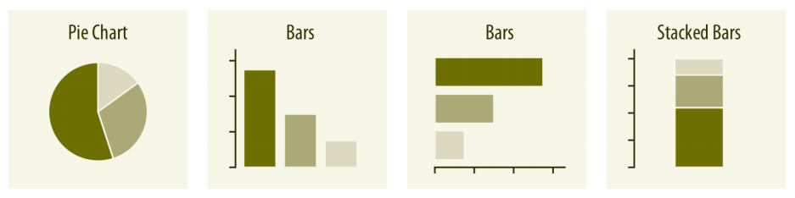
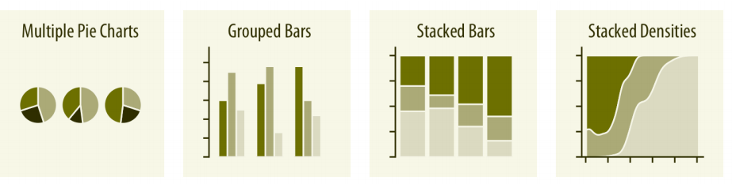
Charts Types: Proportions
Data Visualization
Used to indicate relative portions of a quantitative dependent variable of a single dimension (Pie Charts)
Maps percentage of total to angle of wedge arc (Pie Charts)

Slide 28
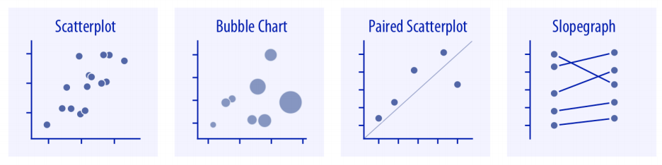
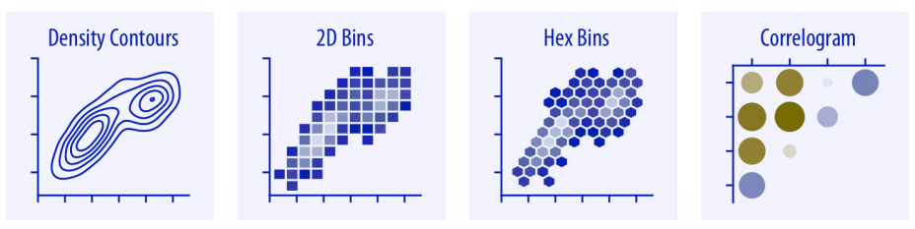
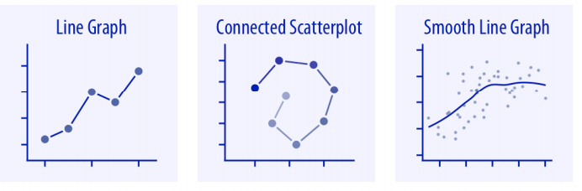
Charts Types: x–y relationships
Data Visualization
Showing one quantitative variable relative to another.
Bubble plots for three quantitative variables.
For large numbers of points, regular scatter plots may become uninformative due to overlapping. In this case contour lines, 2D bins or hex bins may provide alternatives
To visualize more than two quantities we use correlation coefficient in the form of Correlogram
Lines graphs when x axis represents time or strictly increasing quantity.

Slide 29
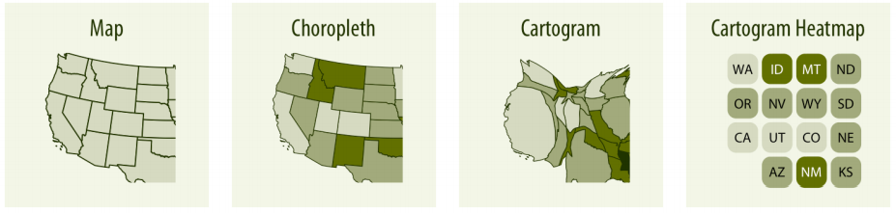
Charts Types: Geospatial Data
Data Visualization
Map forms

Slide 30
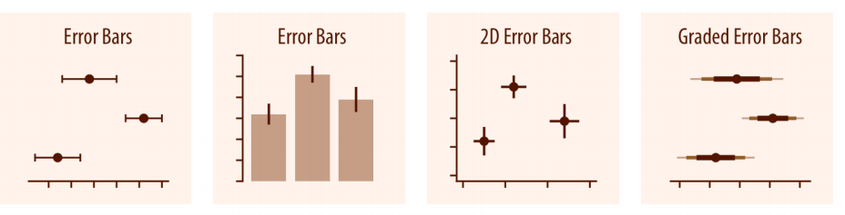
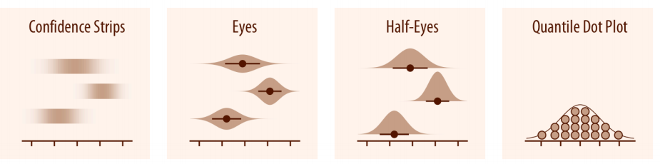
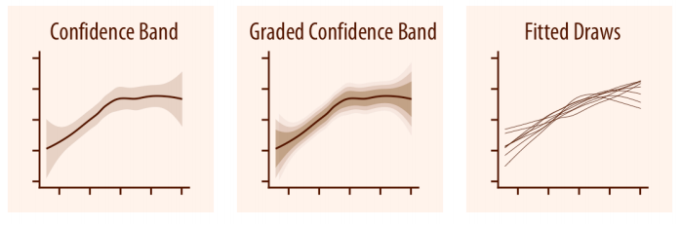
Charts Types: Uncertainty
Data Visualization
Error bars are meant to indicate the range of likely values for some estimates or measurements

Slide 31
Methods:
Data Visualization
Different methods are available for visualization of data based on type of data
Data can be
Univariate
Bivariate
Multivariate

Slide 32
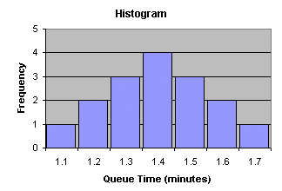
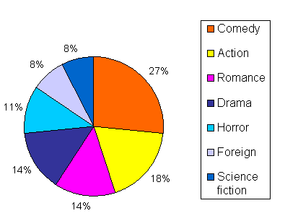
Methods: Univariate
Data Visualization
Measurement of single quantitative variable
Characterize distribution
Represented using following methods
Histogram
Pie Chart

Slide 33
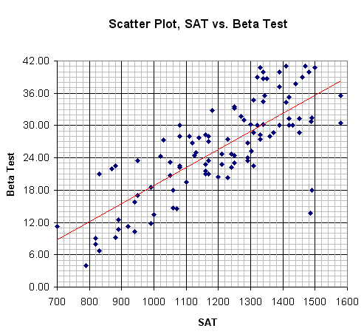
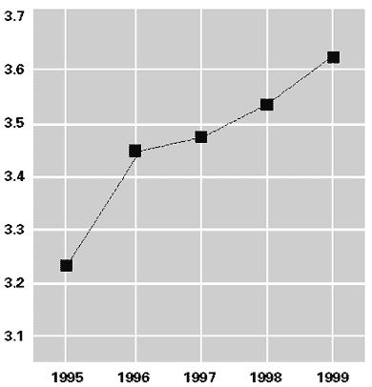
Methods: Bivariate
Data Visualization
Constitutes of paired samples of two quantitative variables
Variables are related
Represented using following methods
Scatter plots
Line graphs

Slide 34
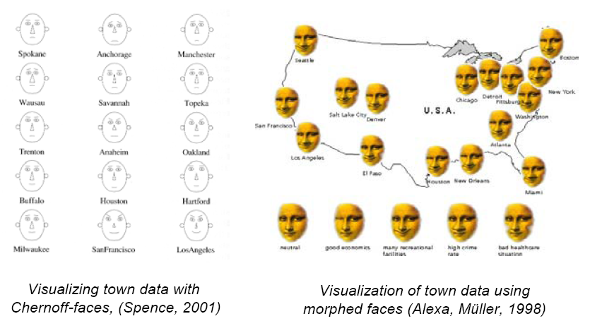
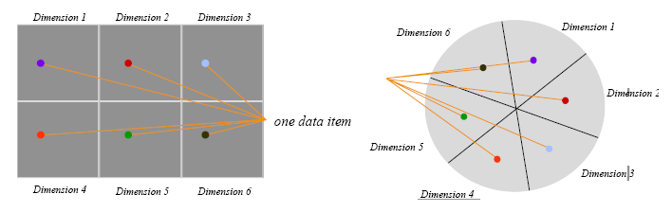
Methods: Multivariate
Data Visualization
Multi dimensional representation of multivariate data
Represented using following methods
Icon based methods
Pixel based methods
Dynamic parallel coordinate system
Icon based Methods
Dense Pixel Display

Slide 35
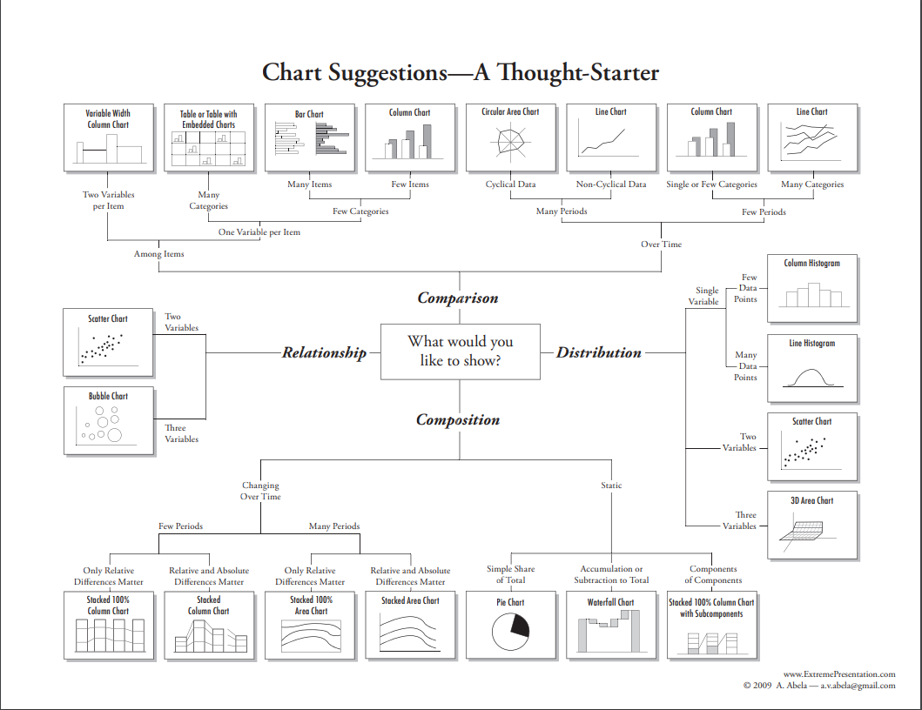
Which Charts should be use?
Data Visualization

Slide 36
Effective Visualization - Principles
Data Visualization
The main principles behind an effective visualization is to
Identify the main audience;
Accurately represent the data;
Create clear presentations that conveys the message to the audience.

Slide 37
Effective Visualization - Principles
Data Visualization
What need to know:
Characteristics of data
Type, size, structure
Semantic, completeness, accuracy
Characteristics of user
Perceptual and cognitive abilities
Knowledge of domain, data, tasks, tools
Characteristics of graphical mapping
What are possibilities
Which convey data effectively and efficiently
Characteristics of Interaction
Which support the tasks best
Which are easy to learn, use, remember

Slide 38
Capabilities:
Data Visualization
Visualization is a powerful tool for qualitative analysis of data and information;
It can be useful for presenting and exploring virtually any data, regardless type, size, complicity, or application domain;
It can be effectively use to detect, isolate, classify data features of interest and guide, and evaluate the results of quantitative data analysis.

Slide 39
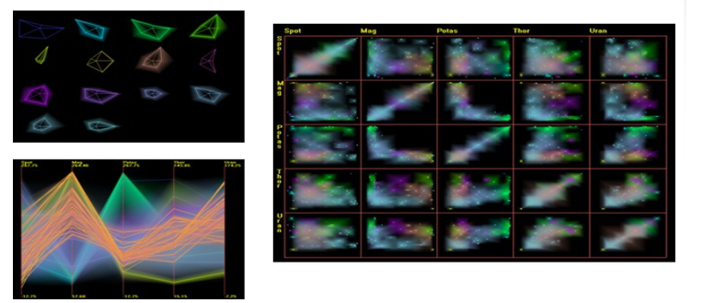
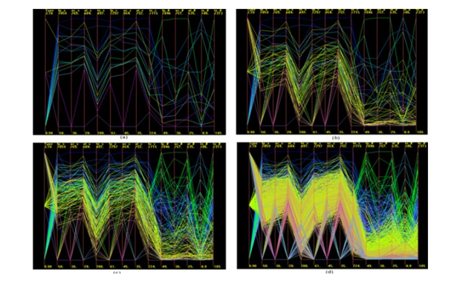
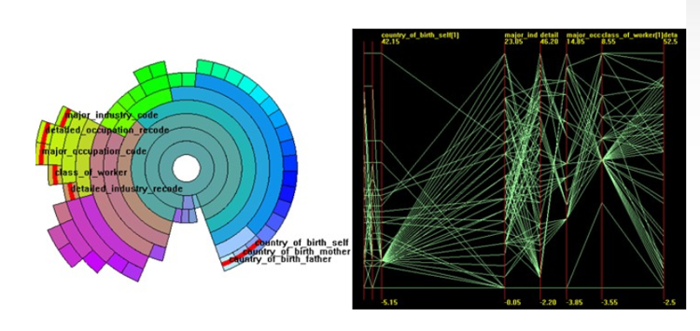
Scale:
Data Visualization
Many datasets contain large number of records and/or dimensions
Several strategies to handle scale problem:
Clustering.
Flittering;
Sampling.
Clustering
Dimensions Clustering
Sampling

Slide 40
Challenges:
Data Visualization
To be clear on the question to be answered from the data
Choosing the right plotting method.
Perceptual Issues:
How accurately do we perceive various graphical features;
How quickly can we detect/classify something visually;
Must understand how users perceive images
How are our abilities affected by training;
How variable is our perception based on the surrounding field of view;
How is our perception affected by stress, age, gender, boredom, fatigue

Slide 41
Limitations:
Data Visualization
Computational Limits
Processing time
System memory
Human Limits
Human attention and memory
Display Limits

Slide 42
Visualization Tools
Tools for building Visualization

Slide 43
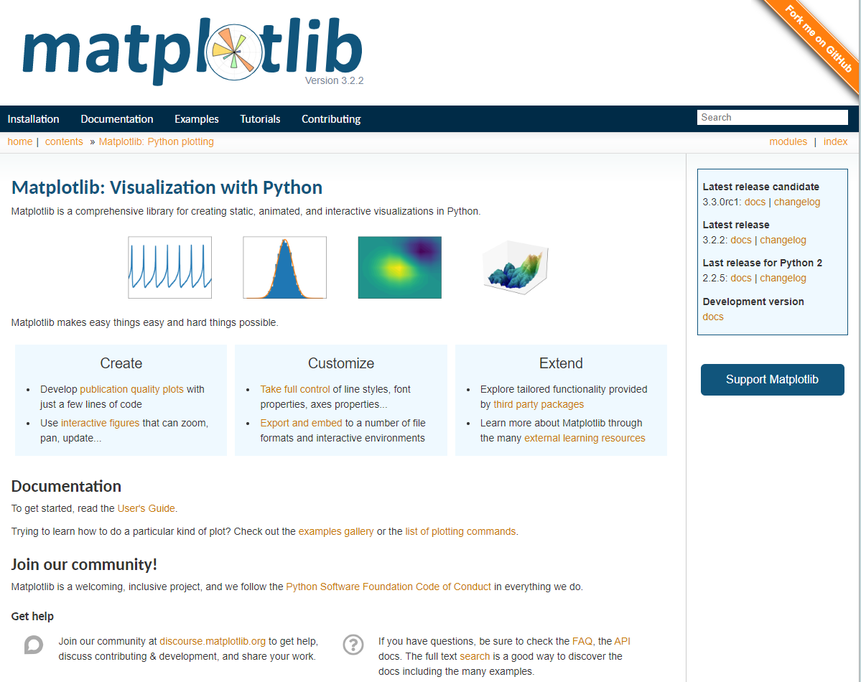
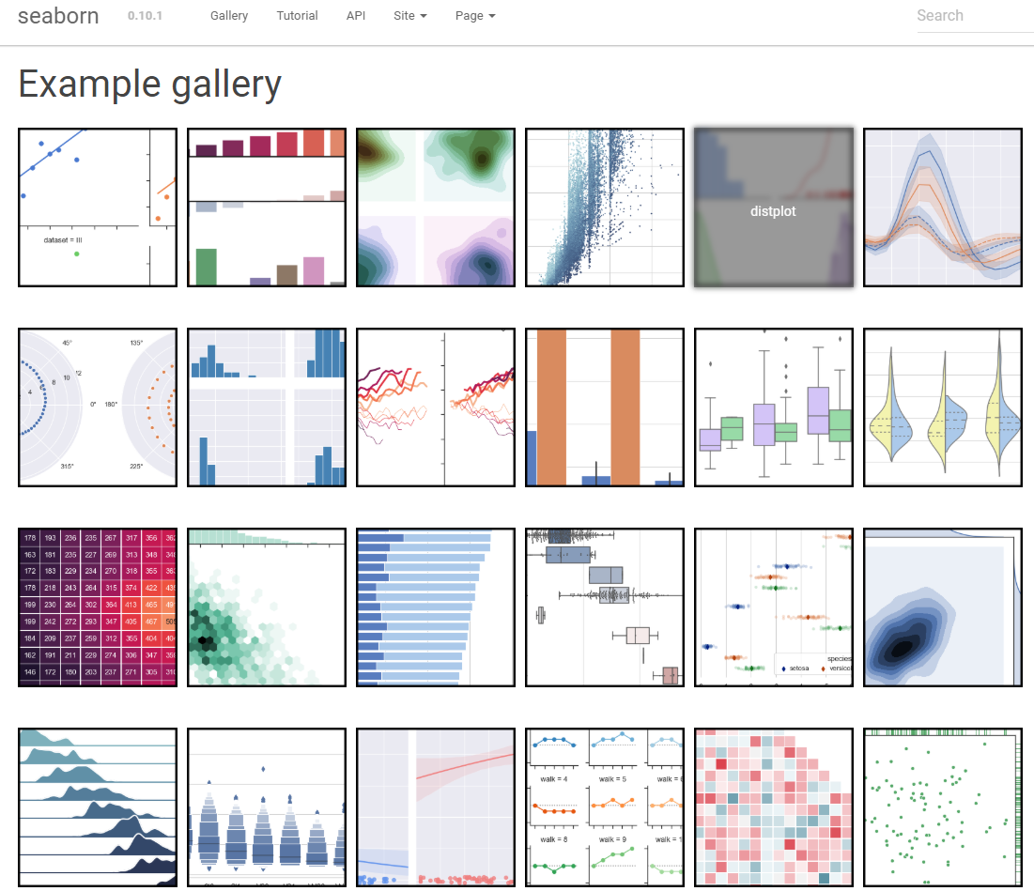
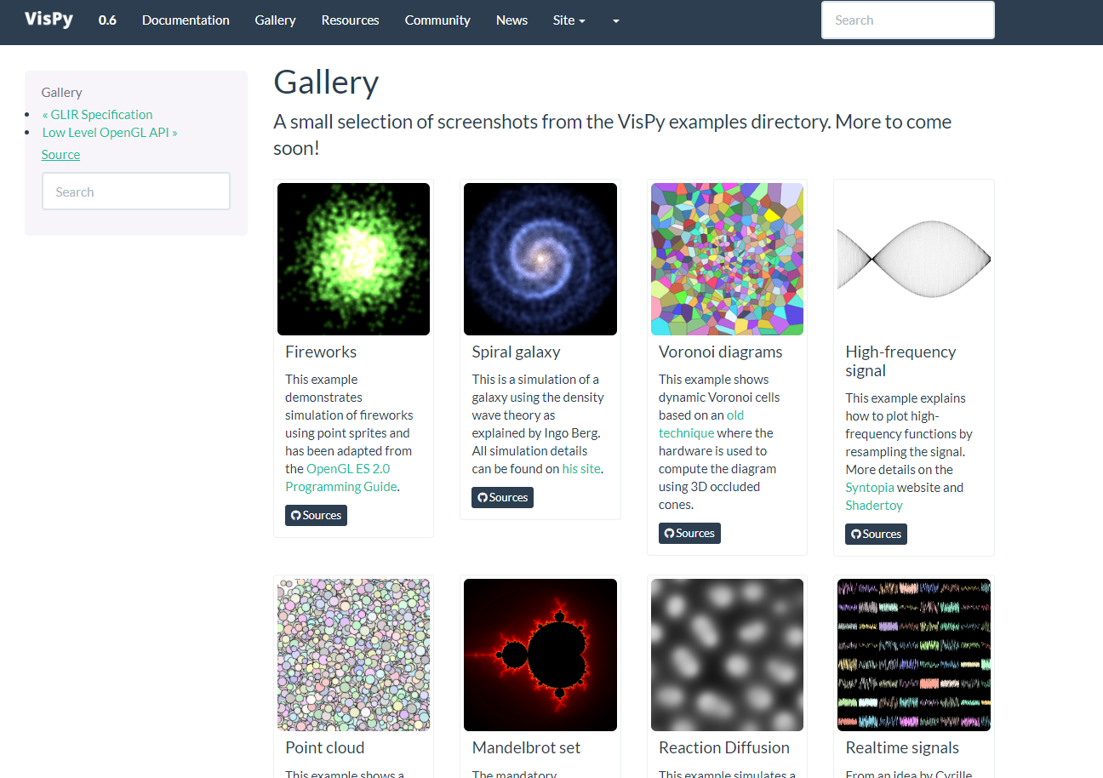
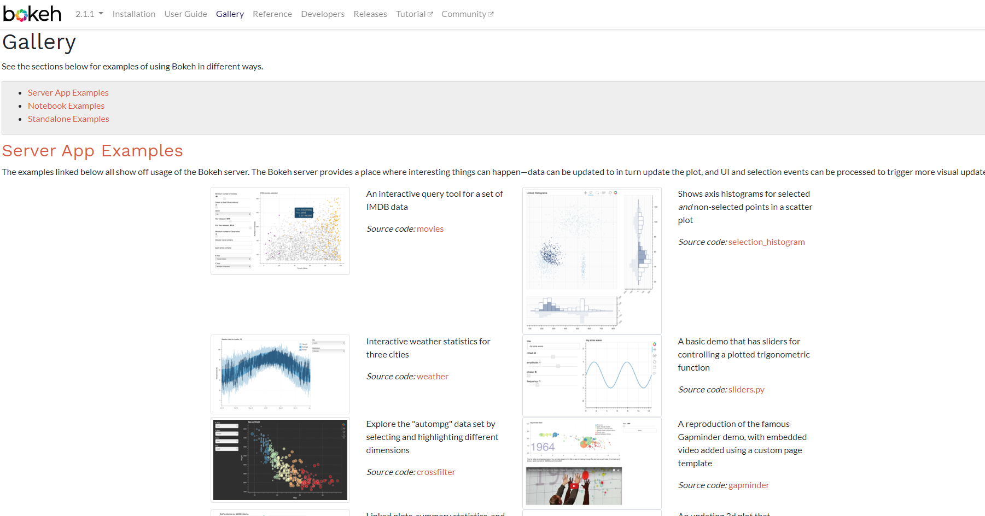
Visualization Tools in Python:
Data Visualization
Plotly
Bokeh
Vispy
Matplotlib
Seaborn
Altair

Slide 44
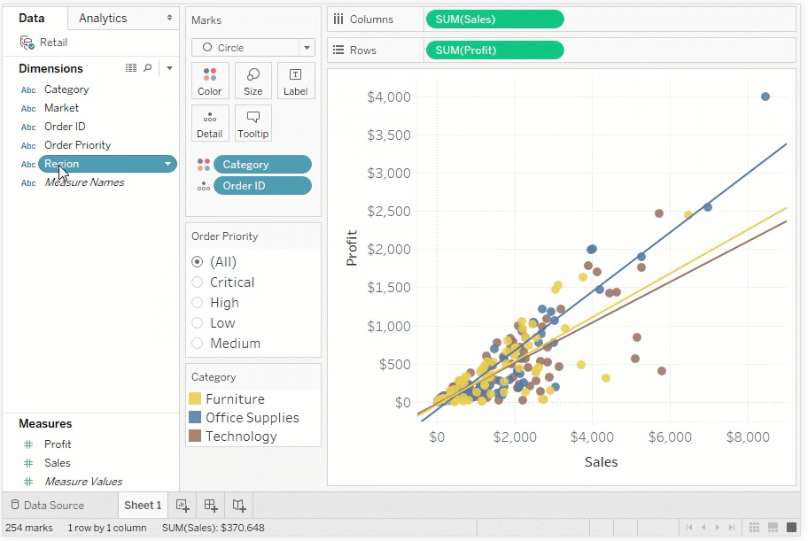
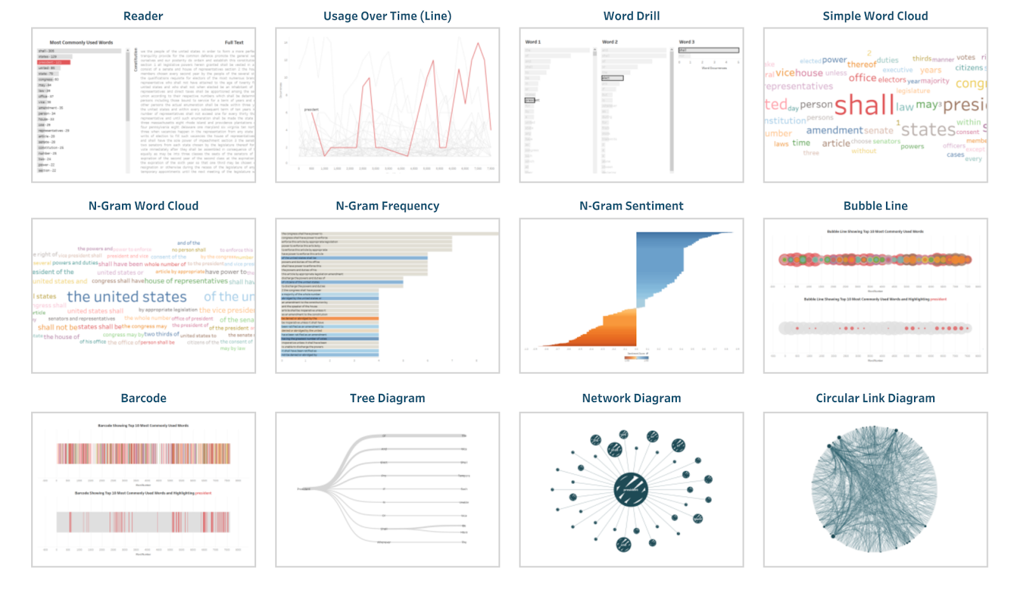
Visualization Tools: Tableau
Data Visualization
Text analysis in Tableau

Slide 45
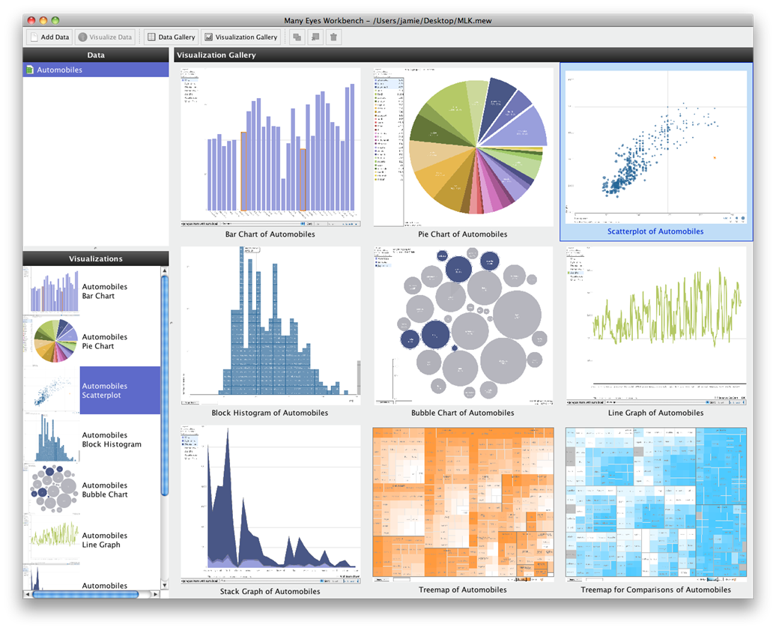
Visualization Tools: Many Eyes
Data Visualization
Visualizations of a tabular dataset in Many Eyes Workbench

Slide 46
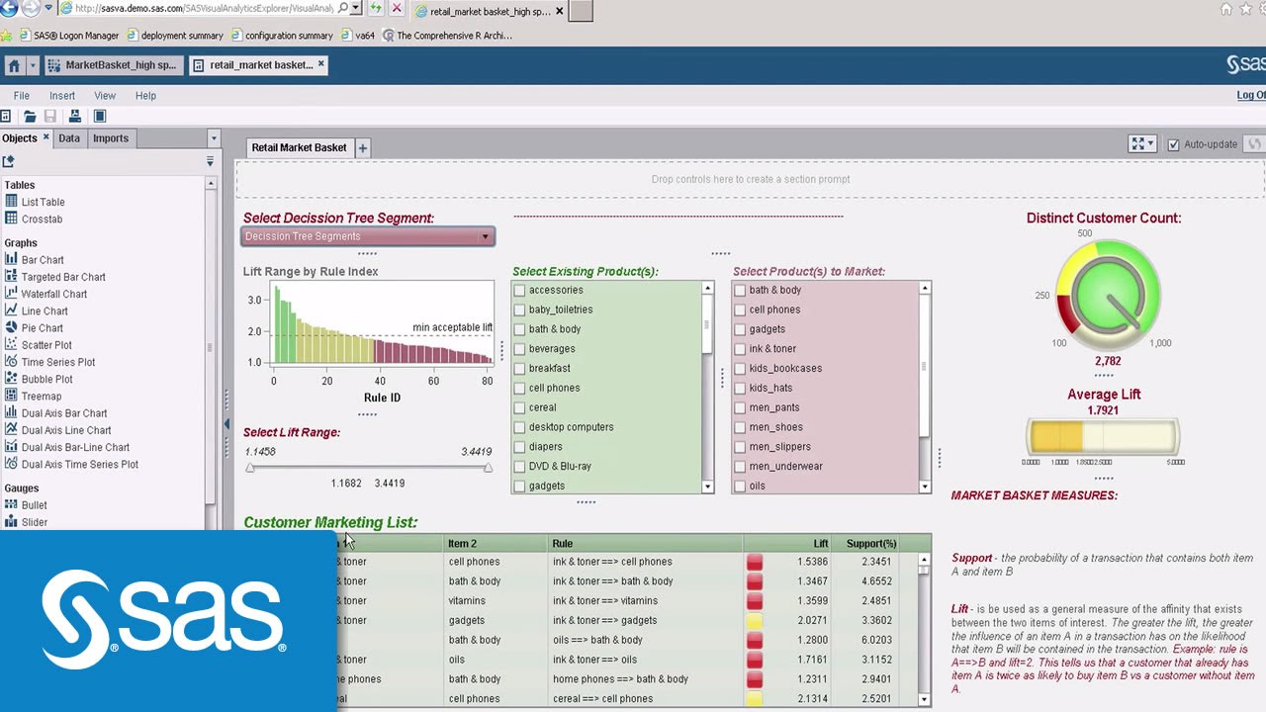
Visualization Tools: SAS
Data Visualization
SAS Visual Analytics for retail

Slide 47
Visualization Dashboards
Organize the visual display of information to provide only the necessary details

Slide 48
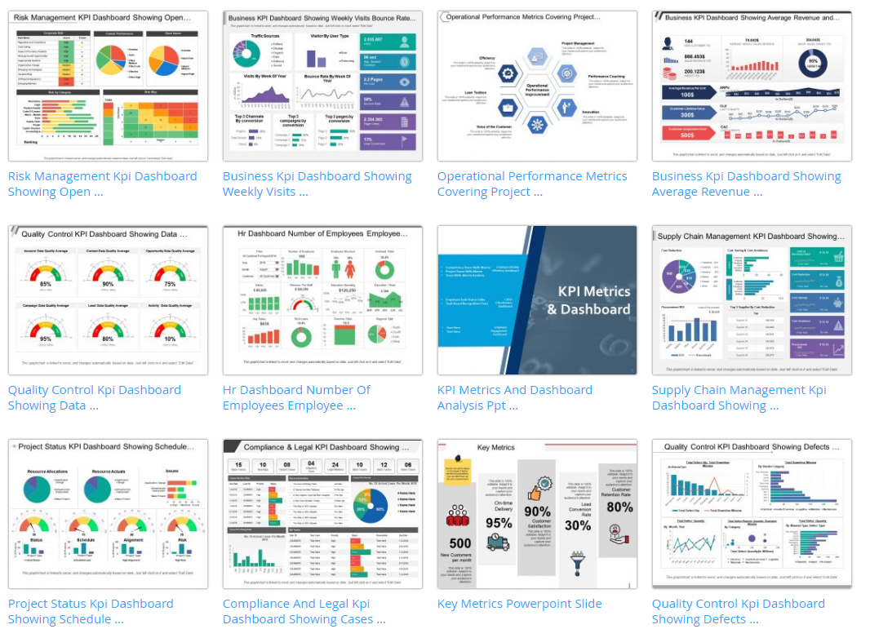
Visualization Dashboards:
Data Visualization

Slide 49
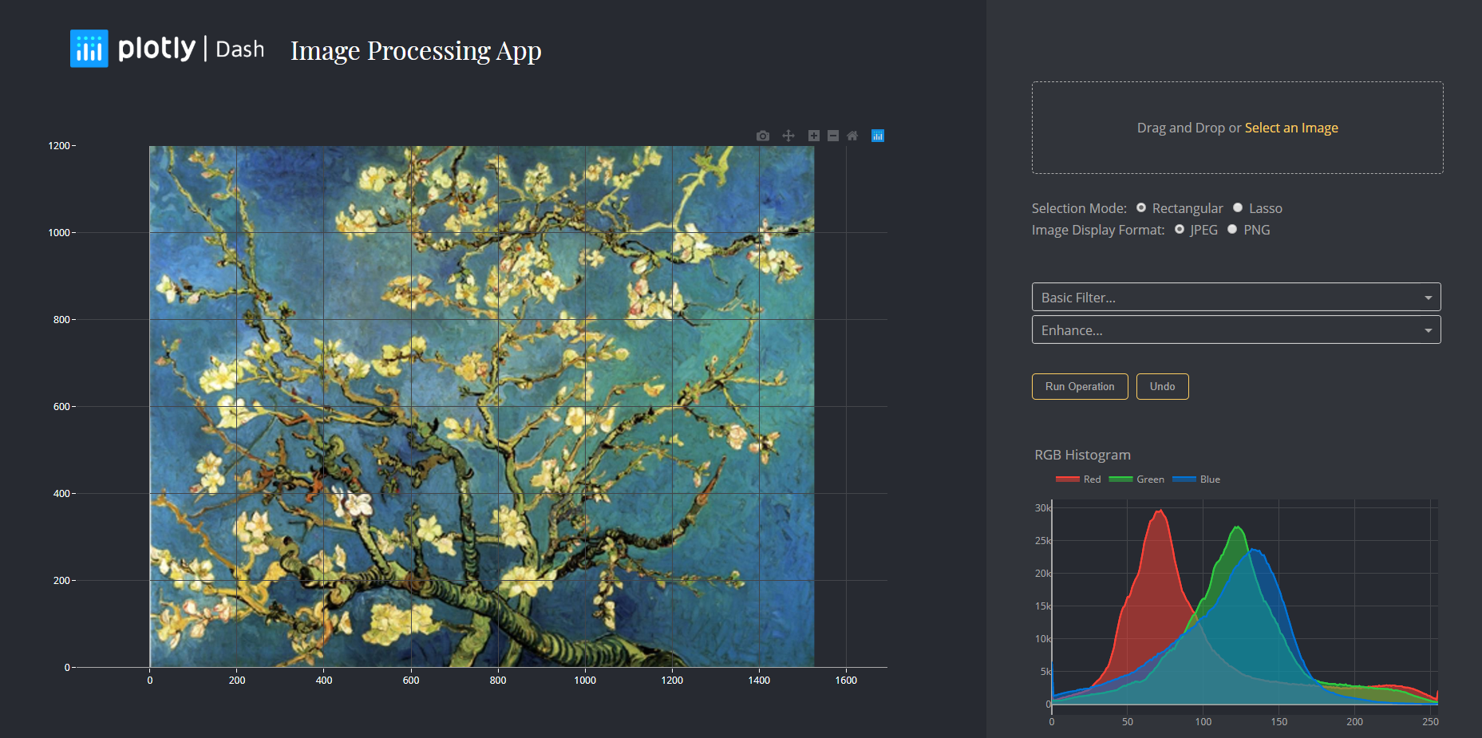
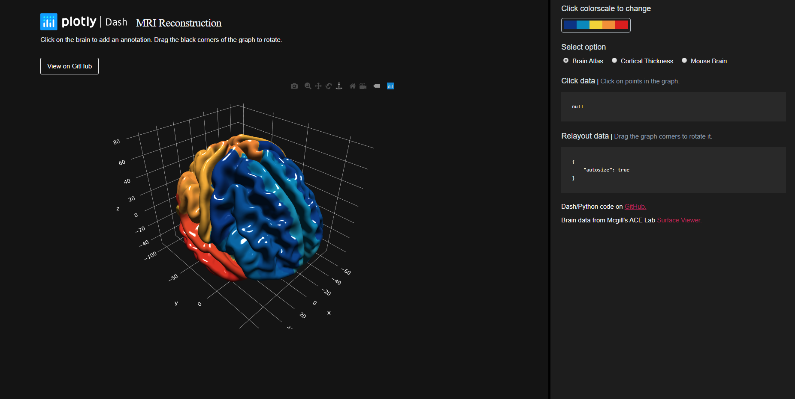
Image Processing Dashboards
Data Visualization

Slide 50
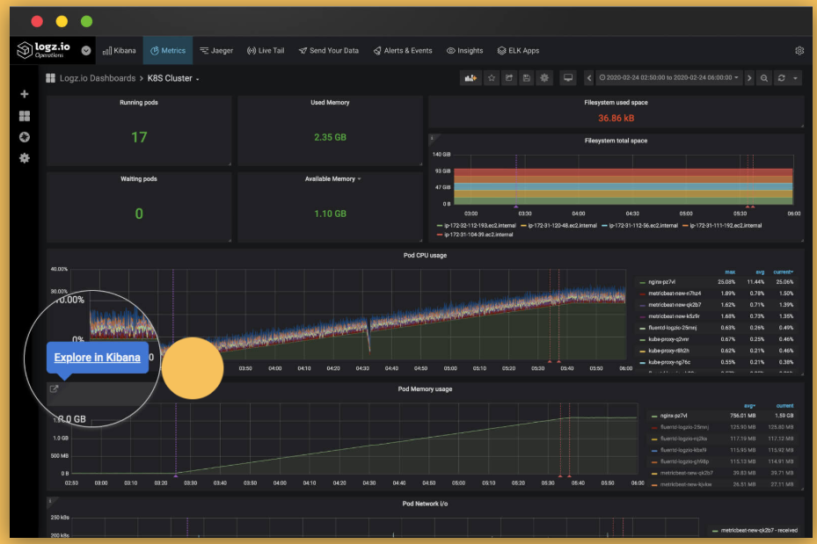
Log Analysis Dashboards
Data Visualization
Logz.io
Based on ELK & Grafana
By tracking log files, DevOps teams and database administrators (DBAs) can maintain optimum database performance or find evidence of unauthorized activity in the case of a cyber attack.

Slide 51


Continuous Integration Dashboards:
Data Visualization
Jenkins: Software Continuous Integrations (CI) Dashboards

Slide 52
Visualization Dashboards: Examples
Data Visualization
Dash App Gallery https://dash-gallery.plotly.host/Portal/
Google Analytics https://support.google.com/analytics/answer/9121111?hl=en&ref_topic=3544907
Web Analytics Dashboard https://www.klipfolio.com/resources/dashboard-examples/marketing/web-analytics

Slide 53
Visual Analytics - Interaction
Data Visualization
The need for Interaction:
All stage of the visualization pipeline can benefit from user interaction;
Explorations require tools for navigation, filtering , selection , and enhancement;
Most recent innovations has focused on developing intuitive, powerful interactive mechanisms;
Interactions can focus on objects, their attributes, or interrelationships.

Slide 54
Visual Analytics - Interaction
Data Visualization
 | Therefore, we need…
Statistical methods alone cannot covey an adequate amount of information for humans to make informed decisions | Visualization
Algorithms alone cannot encode an adequate amount of human knowledge about relevant concepts, facts, and contexts | Interactions
Visualization alone cannot effectively manage levels of details about the data or prioritize different information in the data | Analysis and Interaction
Direct interaction with the data alone is not scalable to the amount of data available | Visual Analytics

Slide 55




References
Data Visualization
Books

Slide 56
References
Data Visualization
Papers
Aharon-Shalom, E., & Heller, A. (2010). Mastering the information age : Solving problems with Visual Analytics- VisMaster Book. Journal of the Electrochemical Society (Vol. 129). https://doi.org/10.1007/BF00250279
Cui, W. (2019). Visual Analytics: A Comprehensive Overview. IEEE Access, 7(June), 81555–81573. https://doi.org/10.1109/ACCESS.2019.2923736
Das, S., Cashman, D., & Endert, A. (2020). Gaggle : Visual Analytics for Model Space Navigation. In Graphics Interface Conference 2020.
Das, S., Xu, S., Gleicher, M., Chang, R., & Endert, A. (2020). QUESTO: Interactive Construction of Objective Functions for Classification Tasks. Eurographics Conference on Visualization (EuroVis) 2020 M. Gleicher, T. Landesberger von Antburg, and I. Viola, 39(3).
Endert, A., Ribarsky, W., Turkay, C., Wong, B. L. W., Nabney, I., Blanco, I. D., & Rossi, F. (2017). The State of the Art in Integrating Machine Learning into Visual Analytics. Computer Graphics Forum, 36(8), 458–486. https://doi.org/10.1111/cgf.13092
Guo, H., Wang, Z., Yu, B., Zhao, H., & Yuan, X. (2011). TripVista: Triple Perspective Visual Trajectory Analytics and its application on microscopic traffic data at a road intersection. IEEE Pacific Visualization Symposium 2011, PacificVis 2011 - Proceedings, (May 2014), 163–170. https://doi.org/10.1109/PACIFICVIS.2011.5742386
Id, O. S. (2010). iVisClassification: An Ineractive Visual Analytics System for Classification Based on Supervised Dimension Reduction, 27–34.
Khayat, M., Karimzadeh, M., Zhao, J., & Ebert, D. S. (2020). VASSL: A Visual Analytics Toolkit for Social Spambot Labeling. IEEE Transactions on Visualization and Computer Graphics, 26(1), 874–883. https://doi.org/10.1109/TVCG.2019.2934266
Kremer, J., Stensbo-Smidt, K., Gieseke, F., Pedersen, K. S., & Igel, C. (2017). Big Universe, Big Data: Machine Learning and Image Analysis for Astronomy. IEEE Intelligent Systems, 32(2), 16–22. https://doi.org/10.1109/MIS.2017.40

Slide 57
References
Data Visualization
Websites
https://www.visualisingdata.com/resources/
https://www.cs.usfca.edu/~apjoshi/msds622/assignments/assignment5.html
https://plotly.com/python/
https://dash.plotly.com/
https://opensource.com/article/19/4/log-analysis-tools
https://stackify.com/best-log-mWebsitesanagement-tools/
https://medium.com/tensult/tools-for-log-analysis-461eb07c2d6b

Slide 58
References
Data Visualization
Online Courses
Data Visualization by University of Illinois at Urbana-Champaign (Coursera)
Introduction to Data Visualization in Python (DataCamp)

Slide 59

Get In Touch
+351 253 510 580
www.ccg.pt
CCG-Centro-de-Computação-Gráfica
info@ccg.pt
Campus de Azurém
Centro de Computação Gráfica
4800-048 Guimarães
Portugal

Slide 60
Thanks

